Slide 1
CgB1201– JAVA PROGRAMMING PROJECT REVIEW-2
Department of Artificial Intelligence and Machine Learning
Academic Year: 2024 – 2025 (Odd Semester)
Register Number : 927623BAM049
Name : SACHIN MR
Year : 2nd YEAR
Semester : 3rd SEMESTER
Date : 05.11.2024

Slide 2
SCHOOL MANAGEMENT SYSTEM

Slide 3
Abstract
The School Management System is designed to streamline administrative tasks by providing an efficient platform.
It includes five main modules, allowing school administrators to enroll students with relevant details, access.
The system's menu-driven interface and error-handling capabilities ensure a user-friendly experience, enabling smooth interaction and data input.
By automating these tasks, the School Management System reduces paperwork, improves accuracy, and enhances the efficiency and effective administrative workflow.
JAVA PROGRAMMING– CYCLE 2 REVIEW

Slide 4
Abstract with CO/PO Mapping
Abstract | CO | POs | PSO
The School Management System is designed to streamline administrative tasks by providing an efficient platform for managing student enrollment automating these tasks, the School Management System reduces paperwork, improves accuracy, and enhances school operations. | CO-1 CO-2 CO-3 | PO1(3) PO2(3) PO3(3) PO4(2) PO5(3) PO6(2) PO7(2) PO8(1) PO9(2) PO10(2) PO10(3) PO11(2) PO12(2) | PSO1(1) PSO2(2)

Slide 5
Introduction
The School Management System is an integrated software solution aimed at simplifying and automating school administration processes.
In educational institutions, managing student information, enrollment, attendance, academic records, and fee payments can be time-consuming and error-prone if handled manually.
This system addresses these challenges by providing a comprehensive platform that organizes and maintains essential student data, enabling school staff to operate more efficiently and effectively.
JAVA PROGRAMMING– CYCLE 2 REVIEW

Slide 6
Java Programming - Concepts Used
Object-Oriented Programming (OOP)
Control Flow
Exception Handling
Data Structures
Methods and Functions
Input/Output Handling
JAVA PROGRAMMING– CYCLE 2 REVIEW

Slide 7
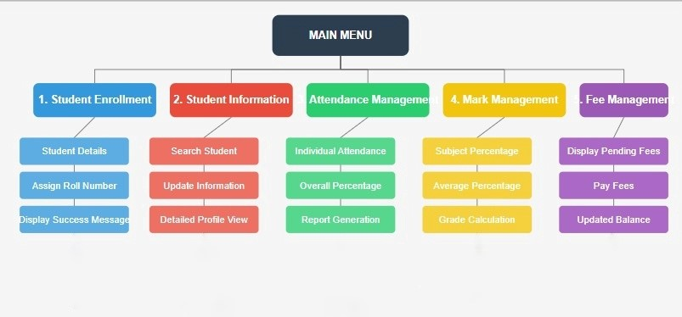
Proposed Architecture
JAVA PROGRAMMING– CYCLE 2 REVIEW

Slide 8
Proposed Architecture - Description
Main Menu: This acts as the central access point, allowing users to navigate to various modules of the system. Each module is represented as an individual section branching from the main menu.
Student Enrollment Module: In this module, users can enter new student information, assign roll numbers, success message upon successful enrollment.
Student Information Module: This module allows users to search for student records, update information, and view detailed profiles.
JAVA PROGRAMMING– CYCLE 2 REVIEW

Slide 9
Proposed Architecture - Description
Attendance Management Module: In this module, users can manage individual attendance records, calculate the overall attendance percentage, and generate attendance reports for each student.
Mark Management Module: This section enables users to manage academic records by calculating subject-wise and overall percentages and assigning grades.
Fee Management Module: The module provides options to display pending fees, allow fee payments, and update the balance after payment.
JAVA PROGRAMMING– CYCLE 2 REVIEW

Slide 10
List of Modules
Student Enrollment Module
Student Information Module
Attendance Management Module
Mark Management Module
Fee Management Module
JAVA PROGRAMMING– CYCLE 2 REVIEW

Slide 11
Module Description
Student Enrollment Module: Allows administrators to enroll new students by capturing essential details
such as name, department, and marks, and assigns a unique roll number.
Student Information Module: Provides quick access to view details of enrolled students
helping administrators manage and review student data effectively.
JAVA PROGRAMMING– CYCLE 2 REVIEW

Slide 12
Module Description
Attendance Management Module: Tracks and displays attendance percentages across subjects
Offering an overview of student attendance records.
Mark Management Module: Records and manages students’ academic scores in various subjects
Enabling efficient tracking of academic performance.
Fee Management Module: Manages student fee transactions
Allowing administrators to view pending fees, process payments, and track remaining balances.
JAVA PROGRAMMING– CYCLE 2 REVIEW

Slide 13
Module Description
Student Enrollment Module
student details
Assign Roll Number
Display success message
JAVA PROGRAMMING– CYCLE 2 REVIEW

Slide 14
Module Description
Student Enrollment Module
This module handles the registration and enrollment of students into the school database.
Student Details: Collect and store essential student information, such as name, roll number and contact information.
Assign Roll Number: Assign unique roll numbers to each enrolled student.
Display Success Message : Show a confirmation message to indicate the successful enrollment of a student.
JAVA PROGRAMMING– CYCLE 2 REVIEW

Slide 15
Module Description
Student Information Module
Search Student
Update Student Information
Detailed Profile View
JAVA PROGRAMMING– CYCLE 2 REVIEW

Slide 16
Module Description
Student Information Module
This module is designed to manage and display detailed information about the students.
Search Student: Allow users to search for a student using criteria such as name, roll number, or class.
Update Information: Enable the modification or updating of existing student details in case of changes
Detailed Profile View: Provide a comprehensive view of the student’s profile, including personal, academic, and contact information
JAVA PROGRAMMING– CYCLE 2 REVIEW

Slide 17
Module Description
Attendance Management Module
Calculate Average percentage
Subject-wise percentage
Grade Calculation
JAVA PROGRAMMING– CYCLE 2 REVIEW

Slide 18
Module Description
Attendance Management Module
This module focuses on monitoring and reporting student attendance.
Individual Attendance: Record and track attendance for individual students on a daily basis.
Overall Percentage: Calculate and display the overall attendance percentage for a student over a specific period.
Report Generation: Generate attendance reports for classes, sections, or individual students for analysis and record-keeping.
JAVA PROGRAMMING– CYCLE 2 REVIEW

Slide 19
Module Description
Mark Management Module
Grade Calculation
Subject-wise percentage
Calculate Average percentage
JAVA PROGRAMMING– CYCLE 2 REVIEW

Slide 20
Module Description
Mark Management Module
This module deals with the recording and analysis of students’ academic performance.
Subject Percentage: Calculate and display subject-wise percentages for each student based on their marks.
Average Percentage: Compute the average percentage of marks across all subjects for a student.
Grade Calculation: Determine and assign grades to students based on their overall academic performance.
JAVA PROGRAMMING– CYCLE 2 REVIEW

Slide 21
Module Description
Fee Management Module
Display pending fees
User can pay fees
Display pending fees
JAVA PROGRAMMING– CYCLE 2 REVIEW

Slide 22
Module Description
Fee Management Module
This module handles the financial transactions and fee-related information for the students.
Display Pending Fees: Show a list of pending fees for individual students, along with due dates.
Pay Fees: Provide functionality for students or parents to pay fees online or offline.
Updated Balance: Display the updated balance or fee status after payment is made, ensuring transparency.
JAVA PROGRAMMING– CYCLE 2 REVIEW

Slide 23
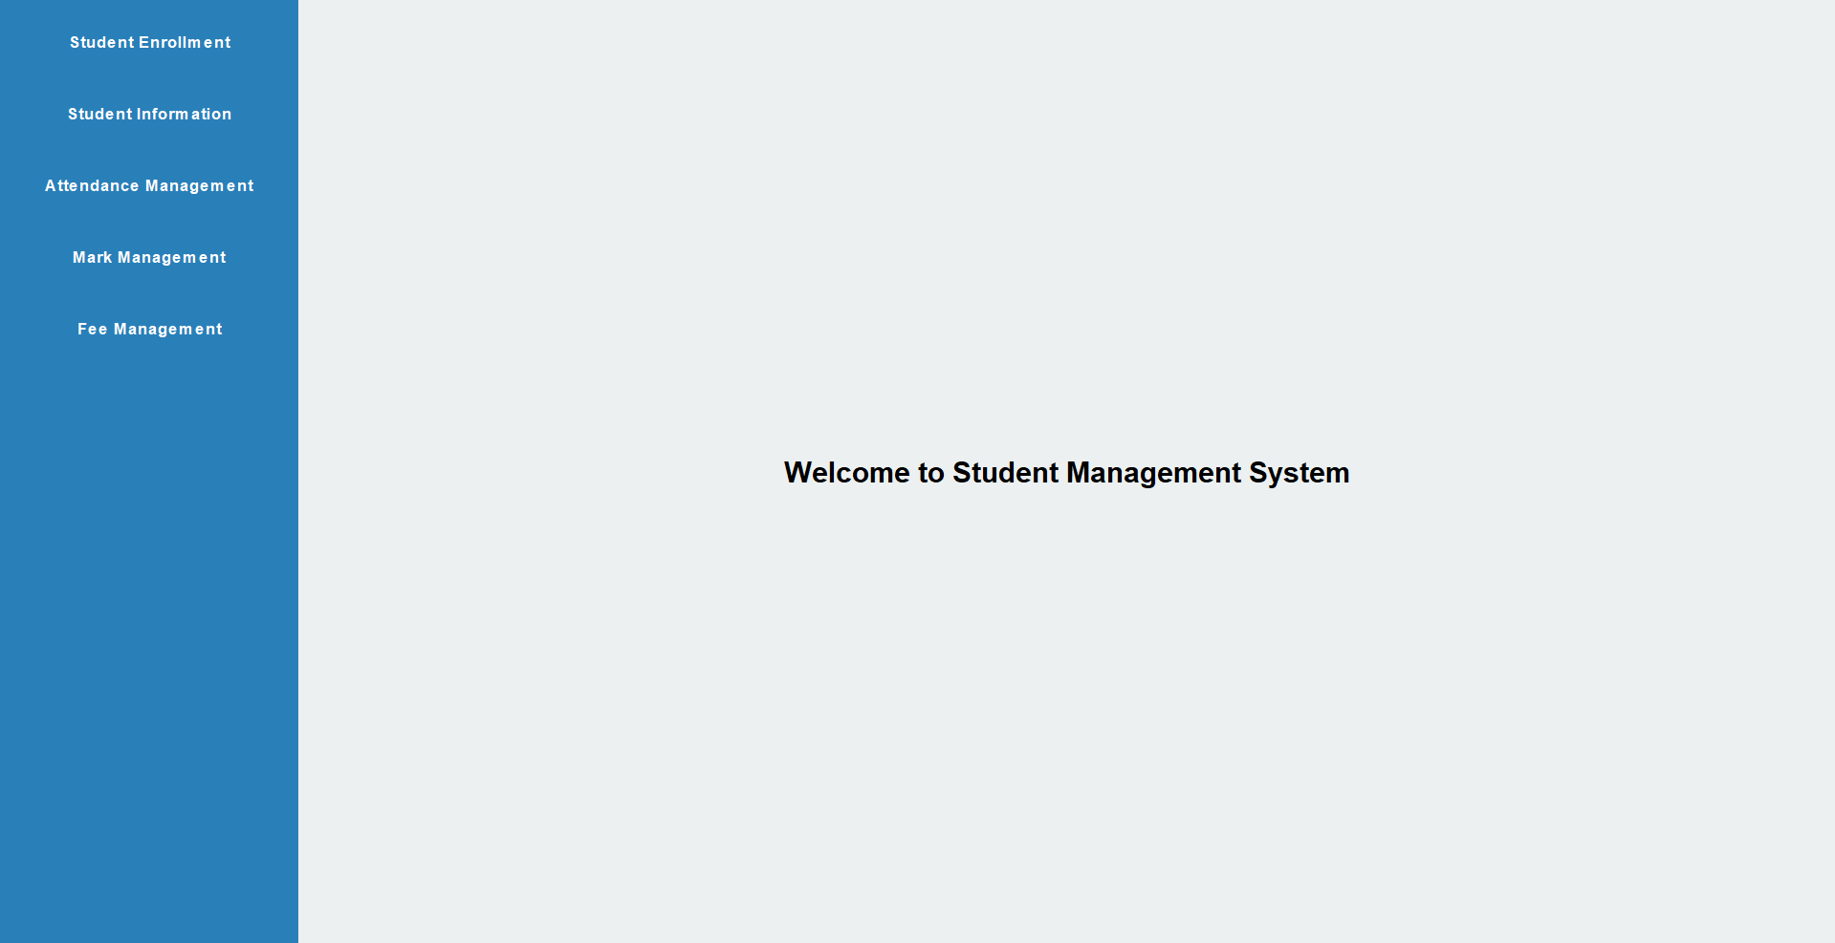
Results and Discussion
JAVA PROGRAMMING– CYCLE 2 REVIEW

Slide 24
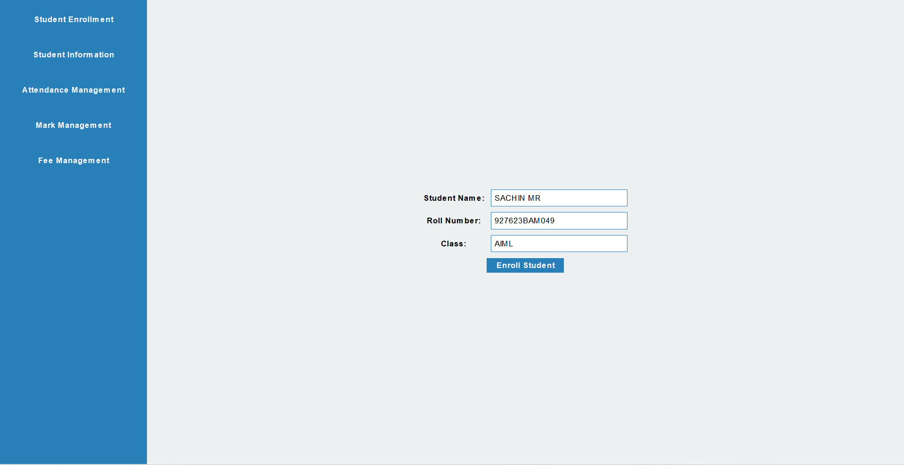
Results and Discussion
JAVA PROGRAMMING– CYCLE 2 REVIEW

Slide 25
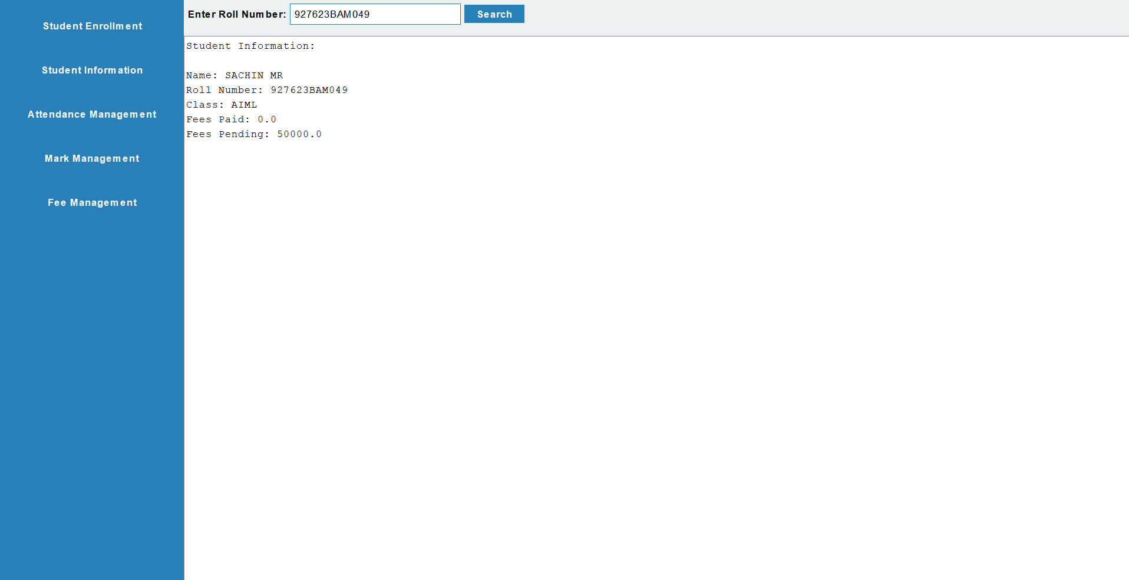
Results and Discussion
JAVA PROGRAMMING– CYCLE 2 REVIEW

Slide 26
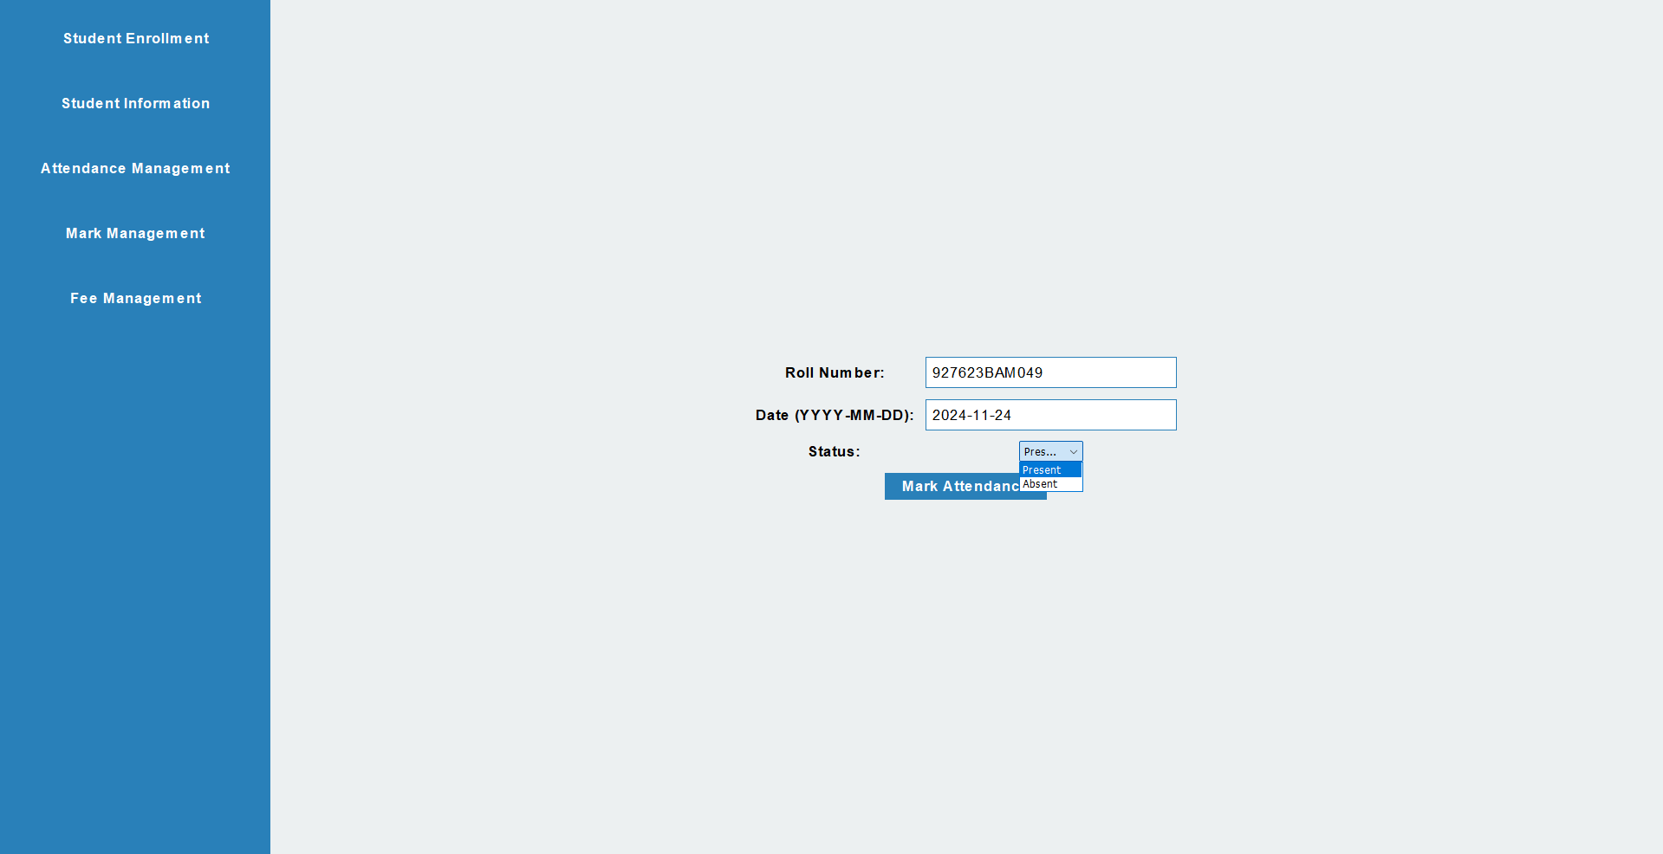
Results and Discussion
JAVA PROGRAMMING– CYCLE 2 REVIEW

Slide 27
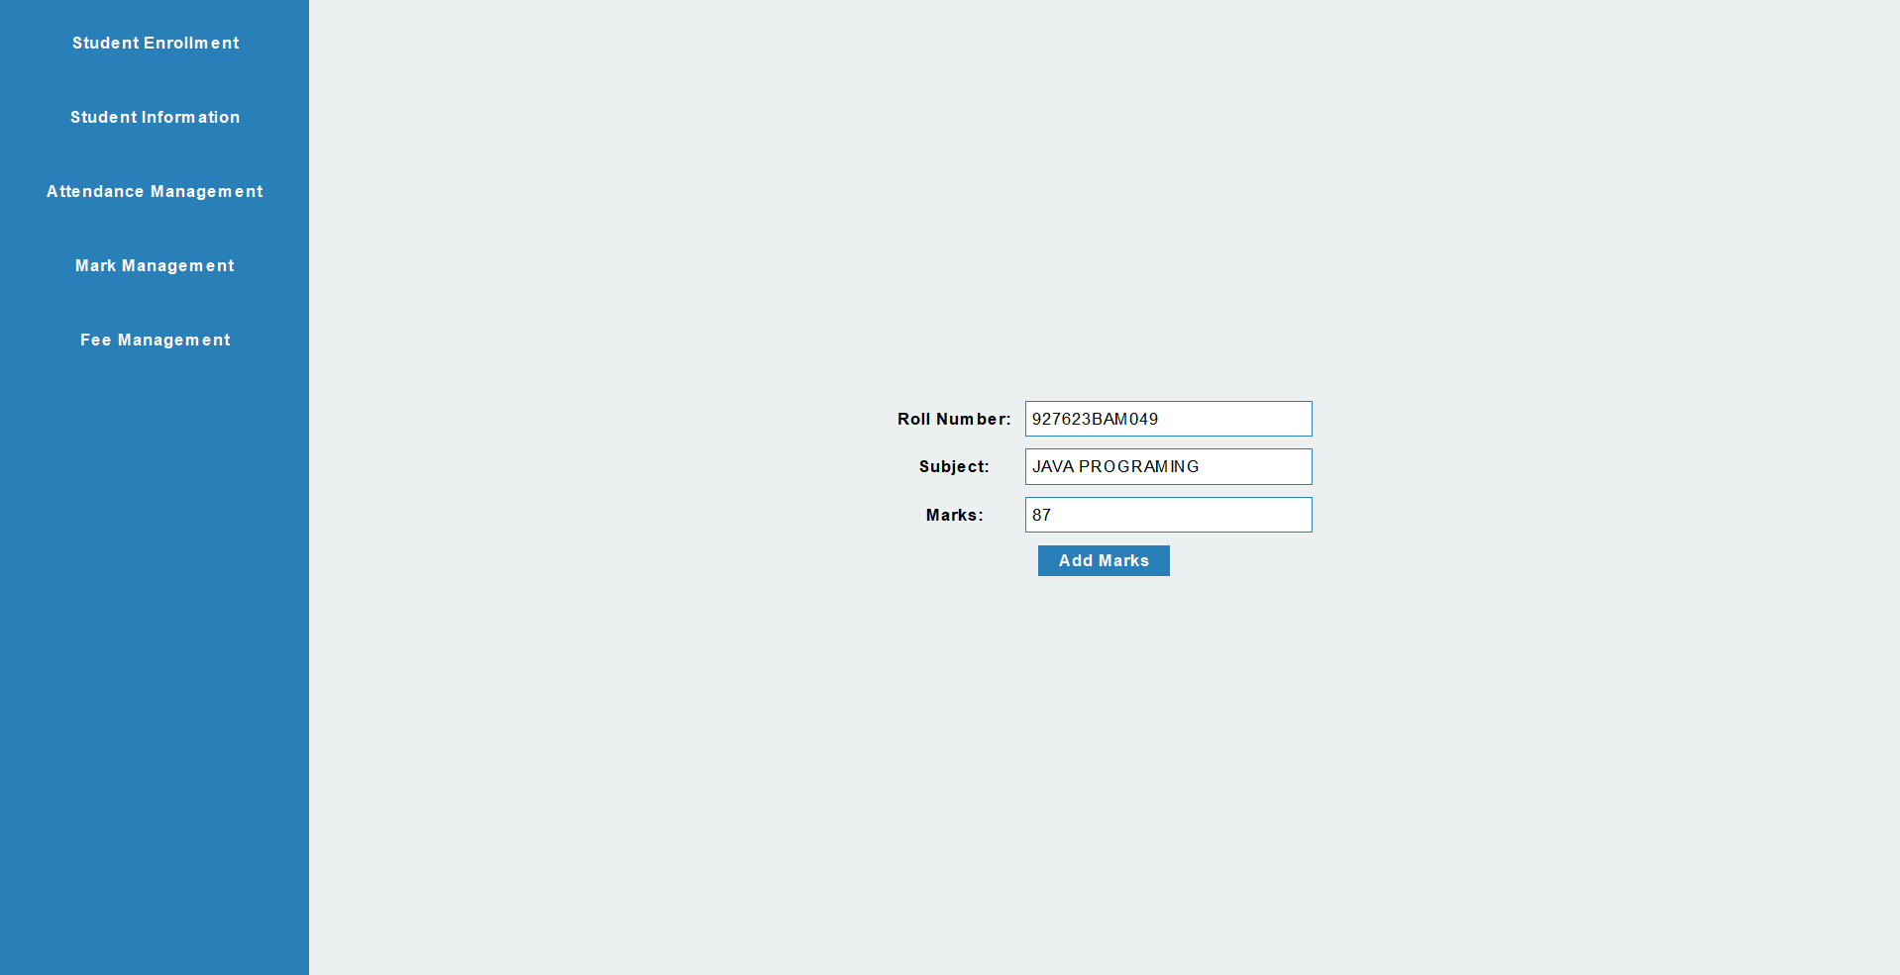
Results and Discussion
JAVA PROGRAMMING– CYCLE 2 REVIEW

Slide 28
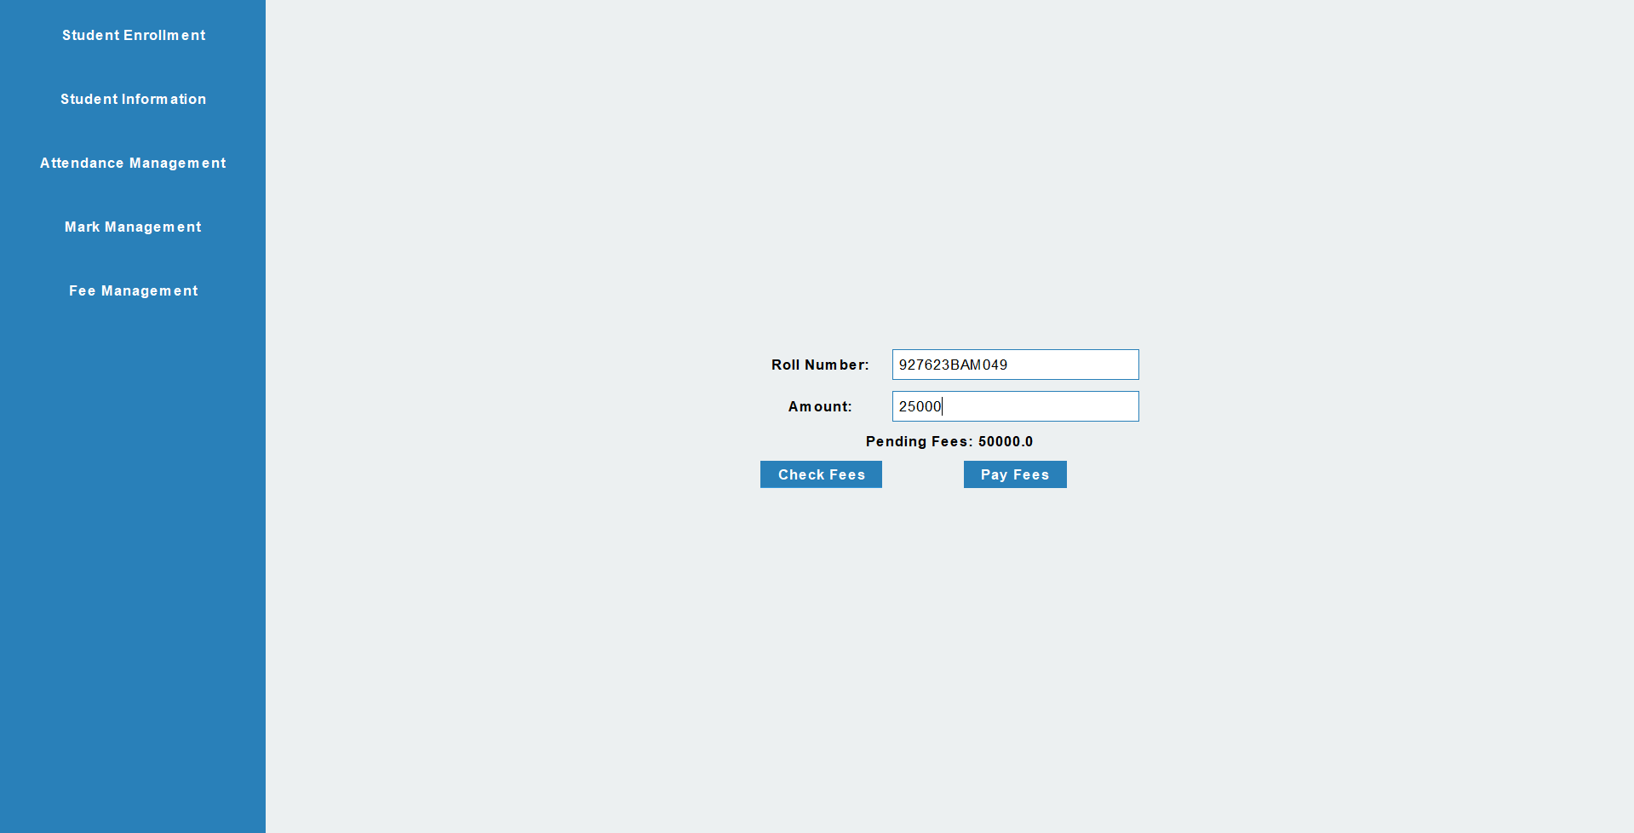
Results and Discussion
JAVA PROGRAMMING– CYCLE 2 REVIEW

Slide 29
Conclusion
The School Management System is an effective tool for automating and organizing essential administrative tasks within educational institutions.
By providing a structured platform for managing student enrollment, attendance, academic records, and fees, this system improves accuracy, reduces the need for manual paperwork, and enhances the efficiency of school operations.
The streamlined, user-friendly interface makes it accessible for administrators, enabling them to perform their tasks with greater ease and reliability.
JAVA PROGRAMMING– CYCLE 2 REVIEW

Slide 30
REFERENCES
Smith, J. (2020). Educational Management Software Design Patterns. Journal of Educational Technology, 15(3), 45-60. Available at: Educational Software Design
Brown, L., & Chen, H. (2021). School Management System Design and Implementation. International Journal of Computer Science in Education, 12(1), 92-107. Available at: School Management Systems
JAVA PROGRAMMING– CYCLE 2 REVIEW

Slide 31
Thank You
Any queries???
JAVA PROGRAMMING– CYCLE 2 REVIEW

